Slide 1

Financial
Industry
Alex. M / Bob

Slide 2


Introduction
Finance Industry
How Do Banks Make Money?
Bank Products
Fundamental Risk
Examples

Slide 3


Finance
Industry

Slide 4

Finance Industry
Insurance
Investment Management
Investment Banks
Non-Depository Institutions
Depository Institutions

Slide 5
Insurance Companies
Finance Industry
Insurance companies issue insurance policies, which are contracts that details the conditions and circumstances under which the insurer will compensate the insured. The insurance transaction involves the insured assuming a guaranteed and known relatively small loss in the form of payment to the insurer in exchange for the insurer’s promise to compensate the insured in the event of a covered loss.
Collateralized Protection Insurance
Lenders purchase CPI in order to manage their risk of loss by transferring the risk to an insurance company. CPI affects only uninsured borrowers or lender-owned collaterals, such as auto repossession and home foreclosure.
Federal Deposit Insurance Corporation (FDIC)
The FDIC insures the deposits of member depository institutions up to $250,000 per account. The FDIC acts in two capacities:
It pays insurance to the depositors, up to the deposit insurance limit, for assets not sold to another bank.
As the receiver of the failed bank, it assumes the task of selling and collecting the assets of the failed bank and settling its debts, including claims for deposits in excess of the insured limit.

Slide 6
Investment Management
Finance Industry
Investment management firms specialized in professional asset management of various securities in order to meet specified investment goals for the benefit of the investors, which may be institutions or private investors.
Mutual Funds & Exchange Traded Funds
Mutual Funds are managed by a Registered Investment Advisory firm that generally charge investors a small fee in exchange for managing their money. The investment objective varies by fund and may be specialized to specific industry or strategy.
Hedge Funds
Hedge Funds are a special type of Registered Investment Advisory firm that may take on leverage to enhance their returns. Generally, these funds charge very high fees (it’s not unlikely for a fund to charge 2% of total assets and 20% of profits) and all investors must be “Accredited Investors.”

Slide 7
Investment Banks
Finance Industry
Investment banks are firms that engages in advisory-based financial transactions on behalf of individuals, corporations, and governments. These firms might assist in raising financial capital by underwriting or acting as the client's agent in the issuance of securities. An investment bank may also assist companies involved in mergers and acquisitions (M&A) and provide ancillary services such as market making, trading of derivatives and equity securities, and FICC services (fixed income instruments, currencies, and commodities).
Transaction Advisory
Transaction advisory helps companies raise funds in capital markets and give advice on mergers and acquisitions (M&A); this may involve subscribing investors to a security issuance, coordinating with bidders, or negotiating with a merger target. A pitch book of financial information is generated to market the bank to a potential M&A client; if the pitch is successful, the bank arranges the deal for the client.
Securities Research
The securities research division reviews companies and writes reports about their prospects, often with "buy", "hold" or "sell" ratings. Investment banks typically have sell-side analysts which cover various industries.

Slide 8
Non-Depository Institutions
Finance Industry
Non-Depository Institutions are companies that do not hold consumer deposits, such as mortgage banks and credit card companies.
Mortgage Bank
Mortgage Banks specialize in origination and/or servicing mortgage loans. Generally, they use a line of credit to fund the loan before it can be sold to an investor, usually a large bank. They primarily make their money from origination fees and servicing fees.
Credit Card Companies
Credit card companies issue revolving credit loans to consumers and businesses using borrowed funds.

Slide 9
Depository Institutions
Finance Industry
Financial institution (such as a savings bank, commercial bank, or credit unions) that is legally allowed to accept monetary deposits from consumers.
Savings Bank
A financial institution whose primary purpose is accepting savings deposits and paying interest on those deposits.
Retail Bank
They can provide financial services to the general public include checking and savings accounts, mortgages, personal loans, credit cards, and certificates of deposit (CDs).
Credit Unions
Credit Unions are controlled by its members and operated on the principle of people helping people, providing its members credit at competitive rates.

Slide 10
How do banks
make money?

Slide 11
Banking Products
How Do Banks Make Money?
Assets
Liabilities
Cash
This is the bank’s “checking account” which is held at the Federal Reserve. The minimum amount of cash that must be held by a bank is 10% of the total deposits*, also known as the Reserve Requirement.
Loans
An amount of money that is lent out and expected to be paid back with interest.
Lines of Credit
An amount of credit that can be borrowed at any time and is expected to be paid back with interest.
Demand Deposits
Funds held in a bank account from which deposited funds can be withdrawn at any time, such as checking accounts.
Savings
Like checking accounts, saving accounts have withdrawal limits over a predefined timespan, but earn higher interest.
Certificate of Deposits
An illiquid deposit for a fixed term that earns a higher rate of interest.
*This is a generalization made for simplicity. The reserve requirements vary by type of deposit and asset base.

Slide 12
Revenue Sources
How Do Banks Make Money?
Revenue Sources Breakdown
Interest
Charges for borrowing money from the lender at a specified rate over the life of the product.
Fees & Commission
Fees are generally charged for certain transactions (foreign currency charges), checking accounts, and annual memberships (credit cards). Commission is charged on trading-related activity on brokerage accounts, such as buying or selling a stock.
Note: All revenue information of Bank of America is for the calendar year 2019 as of 12/31/2019.

Slide 13
Revenue Sources
How Do Banks Make Money?
Fees and Commission Revenue Breakdown
Fees and Commission Revenue Breakdown
Note: All revenue information of Bank of America is for the calendar year 2019 as of 12/31/2019.

Slide 14
Amortization
How Do Banks Make Money?

Slide 15
Fundamental
Risk

Slide 16
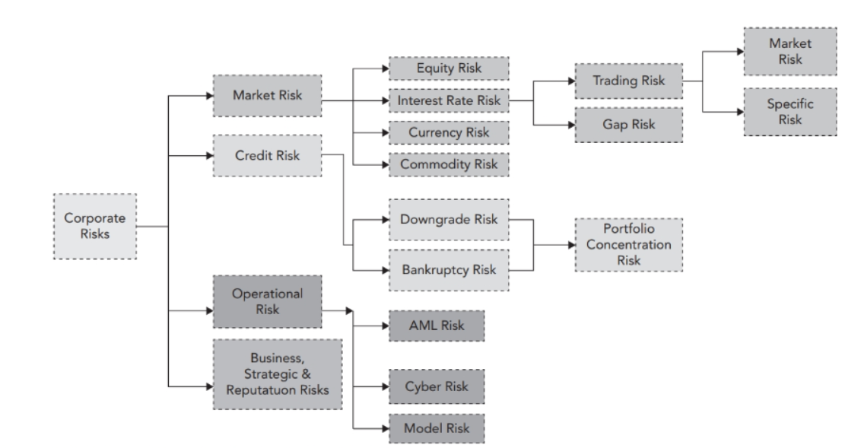
Overview of Risk Types
Fundamental Risk

Slide 17
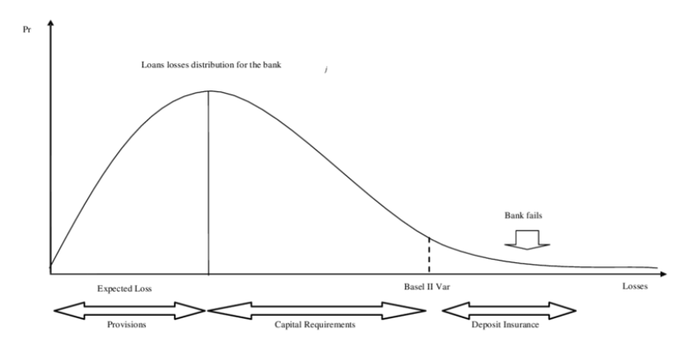
Overview of Risk Types
Fundamental Risk
Provisions: Expected Loss
Capital: Unexpected Loss
Insurance: Extreme Loss

Slide 18
Breakdown
Fundamental Risk
Market Risk
Market prices and interest rates continually change, driving the value of securities and other assets up and down.
Interest Rate Risk
Interest rates drive nearly all market movements, changes in interest rates can have drastic effects on all the economy’s stability and a bank’s revenue stream.
Credit Risk
Credit risk arises from the failure of one party to fulfill its financial obligations to another party.
Liquidity Risk
The financial institution’s ability to maintain a sufficient cash balance to pay all of its obligations.
Operational Risk
Operational risk can be defined as the risk of loss resulting from inadequate or failed internal processes, people, and systems or from external events.

Slide 19
Credit Risk
Fundamental Risk
Internal/External Rating
Many financial institution will have an into evaluate quality of borrower. Santander Risk Weighting is Santander’s internal rating system. Some of the external rating companies for bonds are: Moody Ratings and S&P Ratings.
Default Risk
Risk of counterparty not paying lender back.
Downgrade Risk
A downgrade on a credit rating indicates that the institution is more likely to default.

Slide 20
Liquidity Risk
Fundamental Risk
Liquidity risk is the risk that a bank would not be able to meet its short-term financial demands.
Market Liquidity
Market liquidity refers to the ability to buy or sell a security without affecting its price. An example of illiquidity in non-market terms is the ability for consumers to buy masks during a virus outbreak.
Intraday Liquidity
Throughout the day, millions of deposits, withdrawals, transfers, and payments are made by customers. The bank must be sure that they have sufficient cash throughout the day to meet these demands and therefore closely monitor and forecast their inflows and outflows.

Slide 21
Examples

Slide 22
The Balance Sheet
Examples
Assets
Liabilities + Equity
Cash (Reserves)
$50,000
Loans
$112,500
Lines of Credit
$112,500
Demand Deposits
$10,000
Certificate of Deposits
$40,000
Savings
$200,000
Capital
$25,000
Assets Total: $275,000
Liabilities + Equity Total: $275,000
This is a simplified version of a bank’s balance sheet, which is a financial report that summarizes the company’s assets, liabilities, and equity.

Slide 23
Scenario 1: New Deposits
Examples
Assets
Liabilities + Equity
Cash (Reserves)
$50,000
+$2,000
Loans
$112,500
+$9,000
Lines of Credit
$112,500
+$9,000
Demand Deposits
$10,000
+$20,000
Certificate of Deposits
$40,000
Savings
$200,000
Capital
$25,000
This shows the impact on a bank if a deposit of $20,000 is made.

Slide 24
Scenario 2: Withdrawal
Examples
Assets
Liabilities + Equity
Cash (Reserves)
$50,000
-$20,000
Loans
$112,500
Lines of Credit
$112,500
Demand Deposits
$10,000
Certificate of Deposits
$40,000
Savings
$200,000
-$20,000
Capital
$25,000
This shows the impact on a bank if customer withdraws $20,000 from this savings account.

Slide 25
Scenario 3: Bank Run
Examples
Assets
Liabilities + Equity
Cash (Reserves)
$50,000
-$50,000
Loans
$112,500
-$80,000
Lines of Credit
$112,500
Demand Deposits
$10,000
Certificate of Deposits
$40,000
Savings
$200,000
-$100,000
Capital
$25,000
-$30,000
This shows the impact on a bank if a customer withdraws $100,000 from their savings account. Since they do not have enough cash, the bank decides to sell off loans. However, they would need to be selling them at a loss in order to quickly get convert them to cash. This illustrates one of many ways that banks can meet their funding needs.

Slide 26
Scenario 4: New Loan
Examples
Assets
Liabilities + Equity
Cash (Reserves)
$50,000
-$10,000
Loans
$112,500
+$10,000
Lines of Credit
$112,500
Demand Deposits
$10,000
Certificate of Deposits
$40,000
Savings
$200,000
Capital
$25,000
This shows the impact on a bank if a loan of $10,000 is made.

Slide 27
Scenario 5: Monthly Loan Payment
Examples
Assets
Liabilities + Equity
Cash (Reserves)
$50,000
+$5,000
Loans
$112,500
-$2,000
Lines of Credit
$112,500
Demand Deposits
$10,000
Certificate of Deposits
$40,000
Savings
$200,000
Capital
$25,000
+$3,000
A customer makes a loan payment of $5000, where $3,000 is interest and $2,000 is principal.

Slide 28
Scenario 6: Loan Defaults
Examples
Assets
Liabilities + Equity
Cash (Reserves)
$50,000
Loans
$112,500
-$10,000
Lines of Credit
$112,500
Demand Deposits
$10,000
Certificate of Deposits
$40,000
Savings
$200,000
Capital
$25,000
-$10,000
A $10,000 loan goes into default.

Slide 29


Be Aware of Risk

